Slide 1



Database Management System
203105260
Prof. Shaikh Amin F., Assistant Professor
Computer Science and Engineering, PIET.

Slide 2


UNIT-2
Relational Query Languages

Slide 3
Relational Algebra
In order to query the database instances of a relational databases we have Relational Algebra and Calculus Algebra.
Relational Algebra takes relational database instances as input and yields the instances only as output.

Slide 4
Relational Algebra
Fundamental operations included in the Relational Algebra:
A) Select
B) Project
C) Union
D) Set Difference
E) Cartesian Product
F) Rename

Slide 5
Relational Algebra:
Relational algebra is a language for expressing relational database queries.
A query is a statement requesting the retrieval of information.
Relational algebra is a procedural query language. It requires to specify what data to retrieve as well as how to retrieve those data.

Slide 6
Relational Algebra:
It requires user to instruct the system to perform a sequence of operations on the database to retrieve desired data.
Relational algebra provides the base for commercial query language.
It provides a way to extract data from the database.

Slide 7
Relational Algebra:
Relational algebra consists of a set of different operations.
These operations takes one or two relations as input and produce a new relation as output.
These functions can be divided into two categories:
Fundamental operations: Such as select, project, union, self-difference, Cartesian product, rename etc.

Slide 8
Relational Algebra:
Secondary operations: Such as set-intersection, Natural join, Division and assignment.
Based on number of input relations, these operations can also be categorized as given below:
Unary Operations: Which does the operation on single relation, i.e Select, Project, rename etc.
Binary Operations: Which does the operation on pair of relations, i.e Union, Cartesian product etc.

Slide 9
Relational Algebra:
Based on the number of i/p relations, these operations can also be categorized as:
Unary Operations:
Operates on a single relation.
Examples: Select, Project, Rename etc.
Binary Operations:
Operates on pair of relation.
Examples: Union, Cartesian Product etc.

Slide 10
Relational Algebra:
On the basis of concept of set theory, operations can also be categorized as:
Set-theoretic Operations:
Considers that, relations are essentially set of rows.
Example: Union, Cartesian Product etc.
Native relational Operations:
Focus on structure of rows
Example: Select, Project, Natural Join etc.

Slide 11
Relational Algebra:
Account:
Branch:
Ano | balance | Bname
A01 | 5000 | Vvn
A02 | 6000 | Ksad
A03 | 7000 | Anand
A04 | 8000 | Ksad
A05 | 6000 | vvn
Bname | Baddress
Vvn | Mota bazar, VVNagar
Ksad | Chhota bazar, Karamsad
Anand | Nana bazar, Anand
Employee:
Eid | Name | Mngr_id
E01 | Palak | E03
E02 | Taral | E03
E03 | Jiya | Null
E04 | Saral | E03
E05 | Zalak | E03
E06 | Kamal | E03
E07 | Riya | E03
Customer:
cid | Name
C01 | Riya
C02 | Jiya
C03 | Piya
C04 | Diya
C05 | Tiya
C06 | Palak
C07 | Taral

Slide 12
Relational Algebra:
Here the “Account” relation contains five tuples representing five different accounts.
The “Branch” relation represents three different branches of bank.
The customer relation has only two attributes – cid and name-representing customer id and name.
‘Employee” relation has seven diff. employees along with their employee id and their manager.
An employee E03 has no any manager as he is manager himself.
Also the same person can be customer as well as employee.

Slide 13
The Select operation:
Operation: Selects tuples from a relation that satisfy a given condition.
Symbol: 𝝈 (𝑺𝒊𝒈𝒎𝒂) Notation: 𝝈 condition <Relation>
Operations: =, ≠, <, >, ≤, ≥, AND, OR (V)
For example;
𝝈 (𝒃𝒏𝒂𝒎𝒆) = “vvn” (Account)
Output will be as shown in the table.
Select * from account where bname=‘vvn’;
Ano | Balance | Bname
A01 | 5000 | Vvn
A02 | 6000 | Vvn

Slide 14
The Project operation:
Operation: Selects specified attributes of a relation.
Symbol: 𝝥 (𝑷𝒊) Notation:𝝥attribute set <Relation>
For example; select ano from account where balance<7000;
𝝥(𝒂𝒏𝒐) (𝝈 (𝒃𝒂𝒍𝒂𝒏𝒄𝒆<𝟕𝟎𝟎𝟎) (Account))
Ano | balance | Bname
A01 | 5000 | Vvn
A02 | 6000 | Ksad
A03 | 7000 | Anand
A04 | 8000 | Ksad
A05 | 6000 | vvn
Ano
A01
A02
A05

Slide 15
The Union operation:
Operation: Selects specified attributes of a relation.
Symbol: 𝑼(𝑼𝒏𝒊𝒐𝒏) Notation:𝑹𝒆𝒍𝒂𝒕𝒊𝒐𝒏 𝑼 𝑹𝒆𝒍𝒂𝒕𝒊𝒐𝒏𝟐
Requirements: For relation R and S;
Both have the same Arity, i.e total numbers of attributes
Domains of i^{th} attribute of R and S are same
𝝥(𝒏𝒂𝒎𝒆) (Customer) U 𝝥(𝒏𝒂𝒎𝒆) (Employee)

Slide 16
The Set-Difference (Minus) operation:
Operation: Selects tuples those are in one relation but not in another relation.
Symbol: -(𝑴𝒊𝒏𝒖𝒔) Notation:𝑹𝒆𝒍𝒂𝒕𝒊𝒐𝒏𝟏 − 𝑹𝒆𝒍𝒂𝒕𝒊𝒐𝒏𝟐
Requirements: For relation R and S;
Both have the same Arity, i.e total numbers of attributes
Domains of ith attribute of R and S are same
𝝥(𝒏𝒂𝒎𝒆) (Customer) - 𝝥(𝒏𝒂𝒎𝒆) (Employee)

Slide 17
The Set-Difference (Minus) operation:
cid | Name
C01 | Riya
C02 | Jiya
C03 | Piya
C04 | Diya
C05 | Tiya
C06 | Palak
C07 | Taral
Eid | Name | Mngr_id
E01 | Palak | E03
E02 | Taral | E03
E03 | Jiya | Null
E04 | Saral | E03
E05 | Zalak | E03
E06 | Kamal | E03
E07 | Riya | E03
Name
Piya
Diya
Tiya

Slide 18
The Set-Intersection operation:
Operation: Selects those tuples who are in both relation.
Symbol: ∩(𝑰𝒏𝒕𝒆𝒓𝒔𝒆𝒄𝒕𝒊𝒐𝒏) Notation:𝑹𝒆𝒍𝒂𝒕𝒊𝒐𝒏𝟏∩𝑹𝒆𝒍𝒂𝒕𝒊𝒐𝒏𝟐
Requirements: For relation R and S;
Both have the same Arity, i.e total numbers of attributes
Domains of i^{th} attribute of R and S are same
𝝥(𝒏𝒂𝒎𝒆) (Customer) ∩ 𝝥(𝒏𝒂𝒎𝒆) (Employee)

Slide 19
The Set-Intersection operation:
cid | Name
C01 | Riya
C02 | Jiya
C03 | Piya
C04 | Diya
C05 | Tiya
C06 | Palak
C07 | Taral
Eid | Name | Mngr_id
E01 | Palak | E03
E02 | Taral | E03
E03 | Jiya | Null
E04 | Saral | E03
E05 | Zalak | E03
E06 | Kamal | E03
E07 | Riya | E03
Name
Riya
Jiya
Palak
Taral

Slide 20
The Cartesian-Product operation:
Operation: Selects those tuples who are in both relation.
Symbol: ×(𝒄𝒓𝒐𝒔𝒔) Notation:𝑹𝒆𝒍𝒂𝒕𝒊𝒐𝒏𝟏×𝑹𝒆𝒍𝒂𝒕𝒊𝒐𝒏𝟐
Resultant Relation:
If Relation1 and Relation2 have n1 and n2 attributes, then resultant will have n1+n2, combining both attributes from both relations.
If both relation have same attributes having same name, it can be distinguished by combining ‘Relation-name, Attribute-name”
If Relation1 and Relation2 have n1 and n2 tuples, then relation will have n1*n2 attributes, combining each possible pair of tuples from both relations.

Slide 21
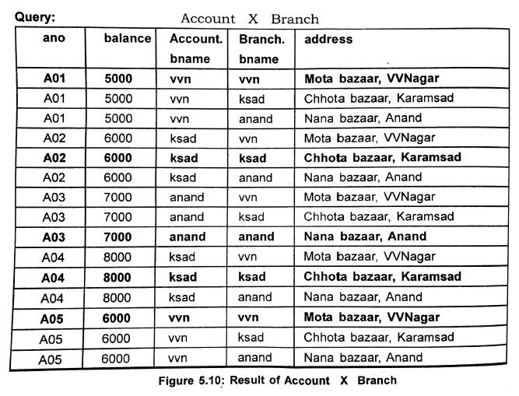
The Cartesian-Product operation:
Operation:
$Account×Branch$

Slide 22
The Cartesian-Product operation:
As you can see here for many tuples, values of ranch name are no same.
For example, second row combines account of ‘vvn’ with ‘ksad’, such tuples provide inconsistent data and they should be removed from the resultant relation.
To defeat such kind of problems, Cartesian product can be combined with “Select” and “Project” statement.

Slide 23
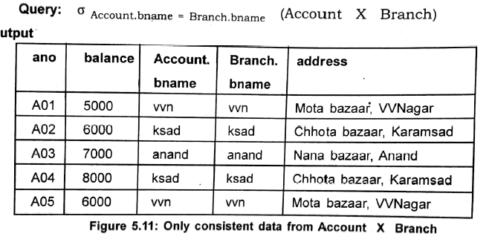
Ano | balance | Bname
A01 | 5000 | Vvn
A02 | 6000 | Ksad
A03 | 7000 | Anand
A04 | 8000 | Ksad
A05 | 6000 | vvn
Bname | Baddress
Vvn | Mota bazar, VVNagar
Ksad | Chhota bazar, Karamsad
Anand | Nana bazar, Anand
The Cartesian-Product operation:

Slide 24
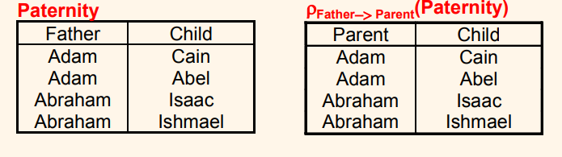
The Rename Operation
This is a unary operator which changes attribute names for a relation without changing any values.
Symbol: ρ
Renames relation as well as its attributes.

Slide 25
SQL3
Sql3 includes data definition and management techniques form object-oriented DBMS, with taking care of relational DBMS platform.
DBMS which supports SQL3 are known as Object-relational or OR-DBMS.

Slide 26
SQL3 features
Abstract data type
A) User defined data types.
B) Equality and ordering functions.
C) Encapsulation: Public, Private, Protected.
D) Inheritance.
Sub-tables that inherit all columns from another table.
Persistent Stored Modules (Programming Language).
User defined operators/functions.
Triggers for events.
External language support.

Slide 27
SQL (Structed Query Language)
Structured Query Language(SQL),the database language, is used to perform certain operations on existing database and also create a database. SQL uses commands like Create, Insert, Update etc. to carry out the required tasks.
These SQL commands are mainly categorized into four categories as:
A) DDL – Data Definition Language
B) DQl – Data Query Language
C) DML – Data Manipulation Language
D) DCL – Data Control Language

Slide 28
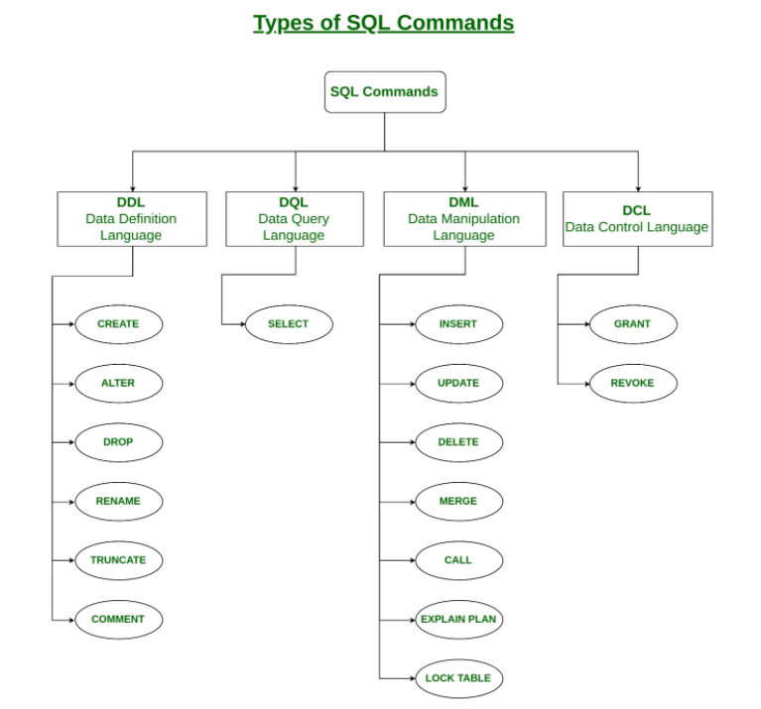
SQL (Structed Query Language)
Types of SQL commands^{[1]}

Slide 29
DDL and DML Constructs
DDL, Data definition language, is the SQL commands set which are used to define the structure of the data structures itself.
Example: Create, Alter etc.
On the other hand, DML, Data manipulation language, is the set of SQL commands used to manipulate the data itself.
Example: Insert, update, delete etc.

Slide 30
DDL and DML Constructs
Examples of DDL commands:
CREATE – is used to create the database or its objects (like table, index, function, views, store procedure and triggers).
DROP – is used to delete objects from the database.
ALTER-is used to alter the structure of the database.
TRUNCATE–is used to remove all records from a table, including all spaces allocated for the records are removed.
COMMENT –is used to add comments to the data dictionary.
RENAME –is used to rename an object existing in the database.

Slide 31
DDL and DML Constructs
Examples of DML:
INSERT – is used to insert data into a table.
UPDATE – is used to update existing data within a table.
DELETE – is used to delete records from a database table.

Slide 32
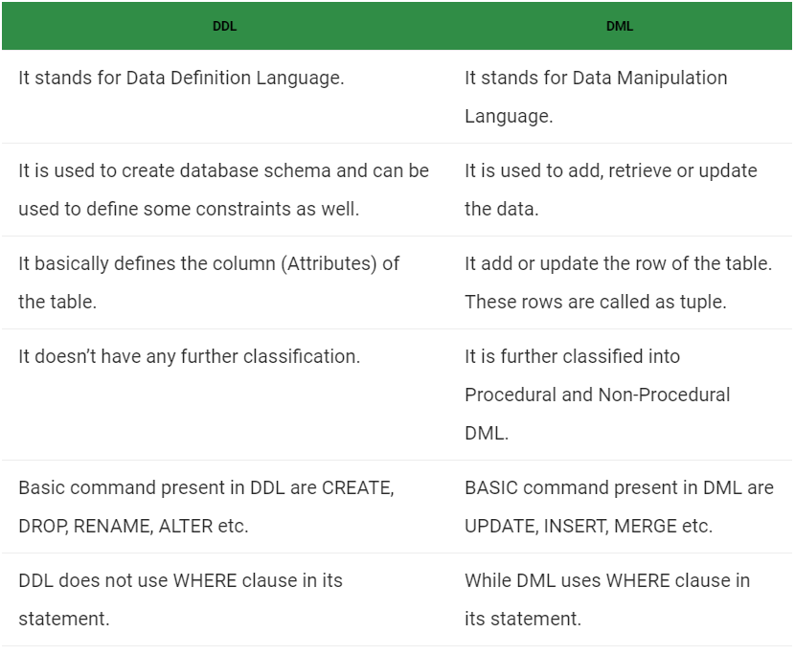
DDL and DML difference
Difference between DDL and DML^{2]}

Slide 33
Commercial and open source DBMSs
COMMERCIAL DBMS
SQL server (Microsoft)
IBM DB2 (IBM)
Oracle
Sybase
Informix (IBM)
Access (Microsoft)
Cache (Intersystems – nonrelational)
OPEN SOURCE DBMS
MySQL
PostgreSQL

Slide 34
Relational Algebra Queries
Consider the following given relational schema: student(S_id, name, enrolled_in, DOB, L_id, division)
lecturer(L_id, L_name, Subject_code)
subject(code, name, lecturer)
TABLE 1: students
S_id | Name | Enrolled_in | DOB | L_id | Division
301 | Riya | AI | 22/03/1999 | 454 | B1
302 | Rohit | ML | 21/01/2000 | 456 | B7
303 | Raman | DBMS | 22/11/2000 | 564 | B10
304 | Shweta | OS | 11/03/2001 | 563 | B8

Slide 35
Relational Algebra Queries
Consider the following given relational schema: student(S_id, name, enrolled_in, DOB, L_id, division)
lecturer(L_id, L_name, Subject_code)
subject(code, name, lecturer)
TABLE 2: lecturer
L_id | L_name | Subject_code
454 | ABC | 03485
456 | XYZ | 03486
564 | ASD | 03567
563 | PQS | 03566

Slide 36
Relational Algebra Queries
Consider the following given relational schema: student(S_id, name, enrolled_in, DOB, L_id, division)
lecturer(L_id, L_name, Subject_code)
subject(code, name, lecturer)
TABLE 3: subject
code | Name | Lecturer
03485 | AI | 454
03486 | ML | 456
03567 | DBMS | 564
03566 | OS | 563

Slide 37
Relational Algebra Queries
Queries related to given tables.
Enlist student enrolled in subject AI.
Π _{S_id} (σ _{enrolled_in = AI} (students))
Who is the FR of student id 302.
Π_{FR_id} (σ _{S_id = 302} (students ))
Enlist the students enrolled in subject AI and ML.
Π_{name} (σ _{enrolled_in = AI} (students)) Ո Π_{name}(σ _{enrolled_in = ML} (students ))
Enlist the faculties who take AI or ML.
Π_{L_name} (σ _{enrolled_in = AI} (students)) ꓴ Π_{name}(σ _{enrolled_in = ML} (students ))

Slide 38
Relational Algebra Queries
Queries related to given tables.
Enlist the student with their FR having division B7.
Π _{name,L_name} (σ _{division = B7} (students lecturer))
Rename table lecturer to faculty.
ρ _{faculty} (lecturer)
Enlist lecturer who is teaching OS and rename it to XYZ.
ρ _{XYZ} (Π _{L_name} (σ _{L_name = OS} (lecturer subject)))
Select faculty id who is FR of Division B7.
Π _{L_id} (σ _{division = B7} (students lecturer))

Slide 39
Relational Algebra Queries
Queries related to given tables.
Enlist the subject taken by faculty ABC.
Π _{name} (σ _{L_name = ABC} (lecturer subject))
Enlist lecturer with subject taken by them and rename it to PQS.
ρ _{PQS}(Π _{L_name, name} (σ _{L_name = ABC} (lecturer subject)))

Slide 40
Relational Calculus
Tuple Relational Calculus:-
In this the set of tuples is selected from a relation.
Expressed as: { T | P (T) }
Here, T is the resulting tuple
P(T) is condition used to deduce T
Example: { T.s_name | Student_name(T) AND T.course = ‘CSE’ }

Slide 41
Relational Calculus
B) Domain Relational Calculus:-
Domain relational calculus is same as tuple relational calculus. Operators are same but domain relational calculus uses connectives, and (˄), or (˅) and not (┐). It uses Existential (∃) and Universal Quantifiers (∀) to bind the variable.
Denoted as: { a1, a2, a3, ..., an | P (a1, a2, a3, ... ,an)}
where, a1, a2 are attributes P stands for formula built by inner attributes

Slide 42
Tuple Calculus Queries
Consider the following given relational schema: student(S_id, name, enrolled_in, DOB, L_id, division)
lecturer(L_id, L_name, Subject_code)
subject(code, name, lecturer)
Queries related to given schema: (Solve using Tuple calculus)
Give student details whose DOB is greater than 21/03/2000.
{ t | t Ɛ students ^ t[DOB] > 21/03/2000 }
Enlist the student enrolled in AI and taught by ABC lecturer.
{ t | Ǝ s Ɛ students(t[L_id] = s[L_id] ^ t[L_name = ABC }

Slide 43
Tuple Calculus Queries
Queries related to given schema: (Solve using Tuple calculus)
Find the lecturer who is FR of division B10
{ t | t Ɛ lecturer ^ t[FR_of_Div] = B10 }
Enlist lecturer and subject who is teaching ML.
{ t | Ǝ s Ɛ lecturer(t[code] = s[Subject_code] ^ t[name = ML }
Enlist student and DOB who took the course DBMS.
{ t | t Ɛ students ^ t[enrolled_in] = DBMS}

Slide 44
SQL Examples
Consider the following tables:
TABLE 1: students
S_id | Name | Enrolled_in | DOB | L_id | Division
301 | Riya | AI | 22/03/1999 | 454 | B1
302 | Rohit | ML | 21/01/2000 | 456 | B7
303 | Raman | DBMS | 22/11/2000 | 564 | B10
304 | Shweta | OS | 11/03/2001 | 563 | B8
305 | Shweta | OS | 07/11/2000 | 563 | B8

Slide 45
SQL Examples
TABLE 2: lecturer
L_id | L_name | Subject_code
454 | ABC | 03485
456 | XYZ | 03486
564 | ASD | 03567
451 | GHJ | 03485
563 | PQS | 03566

Slide 46
SQL Examples
Select rows from table 1 where student is not enrolled in AI.
Select * from Students where NOT enrolled_in = ‘AI’;
Find the list of students name which is 5 character length and ending with t. Select name from students where name LIKE ‘____t’ ;
Find number of students born in year 2000. Select count(DOB) from students
where DOB LIKE ‘%2000’ ;
Select student id and name who are taught by lecturer ASD. Select students.S_id, students.name from students INNER JOIN lecturer ON students.L_id = lecturer.L_id
Where lecturer.L_name = ‘ASD’;

Slide 47
SQL Examples
Update the course enrolled in of student id 303 to TOC. Update students set enrolled_in = ‘TOC’ where s_id = 303 ;
Insert record in table 2 : 345, FGH, 03105 .
Insert into lecturer
values(345, ‘FGH’, 03105) ;
Select students name enrolled in subject whose code is ending with 66. Select students.name from students INNER JOIN lecturer ON students.L_id = lecturer.L_id where lecturer.subject_code LIKE ‘%66’ ;
Select students name from table students with no redundancy. Select DISTINCT(Name) from students ;

Slide 48
SQL Examples
Count number of students in each division and enlist it in a table. Select COUNT(Name) , division from students GROUP BY division ;
Select students name and id with L_id as rename L_id to FR. Select s_id, name, L_id AS FR from students ; Select students id where L_id is 454 or 561. Select S_id from students where L_id = 454 OR L_id = 561 ;
Give student details with DOB in descending order.
Select * from students
order by DOB desc ;
Display division where number of students is greater than 1.
Select COUNT(division) , name from students GROUP BY name ;

Slide 49
SQL Examples
Delete the record from table 2 where subject code is ending with 86.
Delete from lecturer where subject_code LIKE ‘%86’ ;
Change the constraint of table 1 at column enrolled_in to ICT. Alter table students
alter enrolled_in SET DEFAULT ‘ICT’ ;
Add a new column, Phone_no in table lecturer .
Alter table lecturer
ADD Phone_no varchar(12) ;
Use ANY clause and find the details of students who is taught by any lecturer whose name ends with ‘S’.
Select * from students where L_id = ANY (Select L_name from lecturer where L_name LIKE ‘%S’ ;

Slide 50
SQL Examples
Select student id if there exists a student in division B1.
Select S_id from students
where EXISTS (Select * from students where division = ‘B1’ ) ;
Create a virtual table named VT where lecturer name is starting with A.
Create VIEW[VT] AS Select * from lecturer
where L_name LIKE ‘A%’ ;
Remove primary key S_id from students.
Alter table students DROP PRIMARY KEY ;
Count number of lecturers taking subject 03485.
Select count(L_id) from lecturer
GROUP BY subject_code ;

Slide 51
SQL Examples
Select lecturer details where subject code is not 03102, 03103, 03566.
Select * from lecturer
where subject_code NOT IN (03102, 03103, 03566) ;
Select students with DOB greater than 21/03/2000.
Select * from students
where DOB > 21/03/2000 ;
Select details of lecturer who is not teaching any subject i.e., subject_code = NULL.
Select * from lecturer
where subject_code IS NULL ;
Select lecturer who teach subject 03102 and 03485
Select * from lecturer
where subject_code = 03102 AND subject_code = 03485 ;

Slide 52
SQL Examples
Select L_id from table 2 if ALL students in table 1 have division B8.
Select L_id from lecturer
where L_id = ALL (Select L_id from students where division = ‘B8’ ;
Drop table lecturer.
DROP table lecturer ;
Insert values 307, Siya, OS to the table students
Insert into students(S_id, Name, Enrolled_in)
values(307, ‘Siya’, ‘OS’);

Slide 53
Section - 2
Relational Database Design

Slide 54

Domain and data dependency:
Dependencies in DBMS is a relation between two or more attributes. It has the following types in DBMS:
Functional Dependency ( Single and Multivalued Dependency)
Transitive Dependency
Partial Dependency

Slide 55
Functional Dependency:
Let R be a relation schema having n attributes A1, A2, A3,…, An.
Let attributes X and Y are two subsets of attributes of relation R.
If the values of the X component of a tuple uniquely (or functionally) determine the values of the Y component, then, there is a functional dependency from X to Y.
This is denoted by X → Y.
It is referred as: Y is functionally dependent on the X, or X functionally determines Y.
The left hand side of the FD is also referred as determinant whereas the right hand side of the FD is referred as dependent.

Slide 56
Functional Dependency:
EXAMPLE:
Table 1.1: Example of Functional Dependency
Sid | Sname | Cid
S1 | A | C1
S1 | A | C2
S2 | B | C2
S3 | C | C3
Question: If sid → sname is a valid FD?

Slide 57
Functional Dependency:
EXAMPLE:
As we have discussed, for X → Y, for each value of X there should be one Y value.
Sid | → | Sname
S1 |  | A
S1 |  | A
S1 |  | A
S2 |  | B
S3 |  | B
As you can see over here, for each value of Sid there is only one Sname value. Hence, Sid → Sname is valid FD.

Slide 58
Types of Functional Dependency:
Trivial FD:
X→Y is trivial FD if Y is a subset of X.
Every possible Trivial FD is implied in the relation.
For example, Consider Table 1.1. Following FDs are Trivial FDs.
Sid → Sid
Sname → Sname
SidSname → Sname
SidSname → SidSname

Slide 59
Types of Functional Dependency:
Non- Trivial FD:
X→Y is non- trivial FD if there is no common attribute in X, Y attribute set.
For example, Consider Table 1.1.
Sid → Sname is non- trivial FD.

Slide 60
Armstrong's axioms:
Armstrong's axioms are a set of rules used to infer (derive) all the functional dependencies on a relational database.
Let A, B, and C is subsets of the attributes of the relation R.
Rules are mentioned in the next slide.

Slide 61
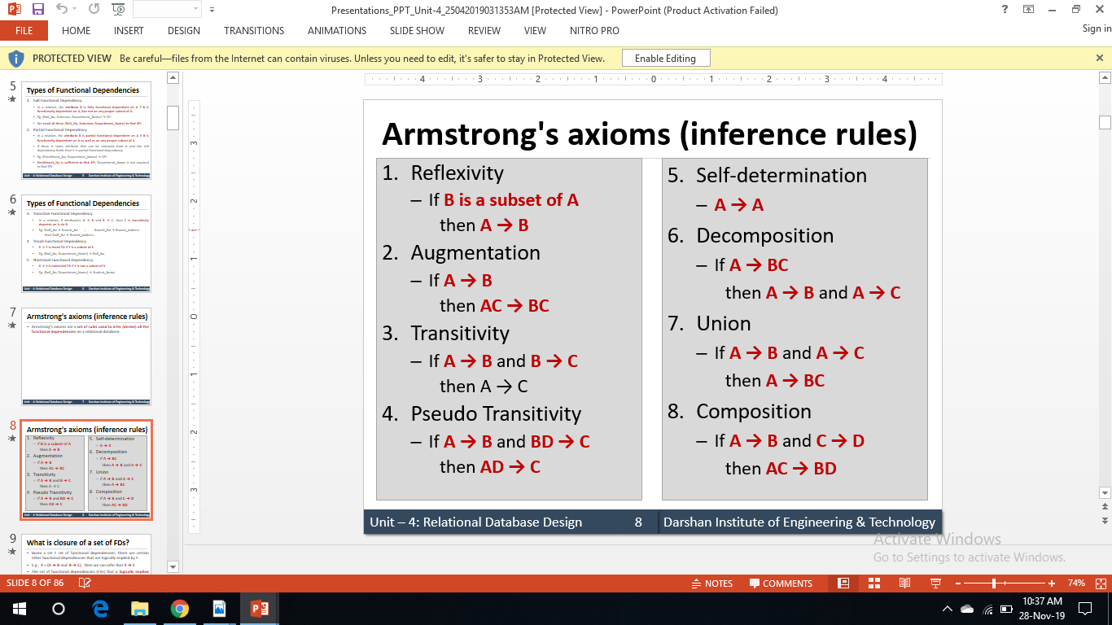
Armstrong's axioms:

Slide 62
Attribute Closure:
Given a set of attributes, the closure of any attribute X under F is the set of attributes that are functionally determined by X under F.
It is denoted by X⁺.
[X]⁺ = { Set of attributes determined by X.}

Slide 63
Attribute Closure:
Example:
Given relation R with attributes A,B,C,D,E,F,G and set of FDs,
F = { A → B, B → C, AC → D, CD → E, G → A, AF → G }.
Find the Closure of and AF.
Answer: A⁺ is { A, B, C, D, E)
[AF]⁺ = { A, B, C, D, E, F, G}

Slide 64
Super Key:
FD’s determine Super key.
X is a Super Key of R iff X⁺ should determine all the attribute of Relation R.
Example: R(ABCD), F = { A → B, B → C, C → D }
[A]⁺ = { A, B, C, D}
Hence, A is one of the super keys.

Slide 65
Candidate Key:
Minimal Super key is Candidate Key.
X is candidate key of Relation R if and only if
X must be super key of R. AND
No proper Subset of attribute X is Super Key.
Prime attributes and Non-Prime Attributes: Attributes of relations which are part of candidate key are known as Prime Attributes and attributes which are not part of candidate keys are known ad non-prime attributes.

Slide 66
Candidate Key:
Example:
R(ABCD), F = { AB → C, C → D, B → E }
[AB]⁺ = { A, B, C, D, E}
Hence, AB is one of the super keys.
To check if AB is Candidate key or not, we have to check closure set of minimal subset of AB, i.e [A]⁺ and [B]⁺
[A]⁺ = {A} (NOT SUPERKEY/CANDIDATE KEY)
[B]⁺ = {BE} (NOT SUPERKEY/CANDIDATE KEY)

Slide 67
Candidate Key:
Note 1: If attribute is in R but not in non-trivial FD set, then that attribute must be part of Candidate key.
Example:
R(ABCDEF), F = { A → D, F → E, C → F, F → A }
Here, B is not part of non-trivial FD set so it must be part of candidate key.
[C]⁺ = { A, C, E, F}
Candidate key: { BC }
Prime attributes: B and C

Slide 68
Candidate Key:
Note 2: If some attribute X is only part of determinant side but not belongs to any determiner of non-trivial FD set of relation R then X must be part of Candidate key.
Example:
R(ABCDEF), F = { AB → C, E → F, D → C, C → B }
Here, A,E are at the determinant side only.
Candidate key: { ABE}
Prime attributes: A,B and E

Slide 69
Candidate Key:
Exercise: Find Candidate Keys of below relations.
R(ABCDE), F = { AB → B, BC → D, CD → E, E → A}
R(ABCD), F = { AB → CD, C → A, D → B}
R(ABCDEF), F = { AB → C, C → DE, E → F, EF → B, E → A}
R(ABCDEFG), F = { AB → CD, AF → D, DE → F, C → G, F → E, G → A}

Slide 70
Normalization:
Normalization is the procedure to reduce the Redundancy.
Redundancy can occur in Relation if two or more independent relations are stored in the single table.
For example, in the given example, two independent relations Student relation and Course relation is stored in single table.

Slide 71
Normalization:
Example of Redundancy:
Table 1.2: Example of Redundancy in Database table.
Sid | Sname | Age | cid | Cname | fees
S1 | A | 20 | C1 | DBMS | 5000
S2 | A | 22 | C1 | DBMS | 5000
S3 | B | 22 | C1 | DBMS | 5000
S2 | A | 22 | C3 | DAA | 7000
S2 | A | 22 | C4 | DS | 7000
Redundancy
Redundancy

Slide 72
Normalization:
Anomalies in Database Design:
Due to redundancy in Database, Inconsistency ( Anomalies ) occurs.
Anomalies are problems that can occur in poorly planned, un-normalized database where all the data are stored in one table.
There are three types of anomalies that can arise in the database because of redundancy are:
Insert anomalies, occur due to Insert Operation.
Delete anomalies, occur due to Delete Operation.
Update / Modification anomalies, occur due to update operation.

Slide 73
Normalization:
Insert Anomaly:
Consider previous example, Student_Course( Sid, Sname, age, Cid, Cname, fees) as Sid as a primary key.
Let us assume that a new course has been started by the Institute but initially there are no students enrolled for that course.
Then the tuple for this course cannot be inserted in to this table as the Sid will have NULL value, which is not allowed because Sid is primary key.
This kind of problem in the relation where some tuple cannot be inserted is known as insert anomaly.

Slide 74
Normalization:
Insert Anomaly:
Table 1.3 : Insert Anomaly
Sid | Sname | Age | cid | Cname | fees
S1 | A | 20 | C1 | DBMS | 5000
S2 | A | 22 | C1 | DBMS | 5000
S3 | B | 22 | C1 | DBMS | 5000
S2 | A | 22 | C3 | DAA | 7000
S2 | A | 22 | C4 | DS | 7000
NULL | NULL | NULL | C5 | CD | 8000
Insert Anomaly

Slide 75
Normalization:
Delete Anomaly:
Consider previous example, Student_Course( Sid, Sname, age, Cid, Cname, fees) as Sid as a primary key.
Now consider there is one student in and that employee leaves the Institute.
Then the tuple of that student has to be deleted from the table, but in addition to that information about the course also will be deleted.
This kind of problem in the relation where deletion of some tuples can lead to loss of some other data not intended to be removed is known as delete anomaly.

Slide 76
Normalization:
Delete Anomaly:
If student C leaves the institute, then we have to delete information related to that particular student. If we delete that, information regarding course C3 will be deleted.
Table 1.4 : Deletion Anomaly
Sid | Sname | Age | cid | Cname | fees
S1 | A | 20 | C1 | DBMS | 5000
S2 | A | 22 | C1 | DBMS | 5000
S3 | B | 22 | C1 | DBMS | 5000
S2 | A | 22 | C3 | DAA | 7000
S2 | A | 22 | C4 | DS | 7000

Slide 77
Normalization:
Update Anomaly:
Consider previous example, Student_Course( Sid, Sname, age, Cid, Cname, fees) as Sid as a primary key.
Suppose the fees of a course has changed, this requires that the course in all the tuples corresponding to that course must be changed to reflect the new status.
If we fail to update all the tuples of given course, then two different records of the student enrolled in the same course might show different fees which leads to inconsistency in the database.
This kind of problem is known as update or modification anomaly.

Slide 78
Normalization:
Update Anomaly:
Table 1.5 : Update Anomaly
Sid | Sname | Age | cid | Cname | fees
S1 | A | 20 | C1 | DBMS | 6000
S2 | A | 22 | C1 | DBMS | 5000
S3 | B | 22 | C1 | DBMS | 5000
S2 | A | 22 | C3 | DAA | 7000
S2 | A | 22 | C4 | DS | 7000
Update Anomaly

Slide 79
Normalization:
Need of Normalization:
Eliminates redundant data
Reduces chances of data errors
Reduces disk space
Improve data integrity, scalability and data consistency.

Slide 80
Normalization:
Normal forms:
1 NF ( First normal form)
2NF ( Second normal form)
3NF ( third normal form)
BCNF
4NF ( forth normal form)
5NF ( fifth normal form)
0% redundancy over Single valued FD’s. (X→Y)
Redundancy can be possible because of MVD’s. (X→ → Y)
No Redundancy because of MVD’s also

Slide 81
Normalization:
1NF:
Relational schema R is in 1 NF if no multivalued attribute in Relation R.
Or
Every attribute of relation R must be single valued.

Slide 82
Normalization:
1NF:
Consider below relation.
Above relation has three attributes CustomerID, Name, Address.
Here address is composite attribute which is further divided in to sub attributes as Area and City.
So above relation is not in 1NF.
Table 1.6: 1 NF Example
CustomerID | Name | Address
C01 | A | Karelibag, Vadodara
C02 | B | Satellite, Ahmedabad

Slide 83
Normalization:
1NF:
Consider below relation.
Problem:
It if difficult to retrieve the list of Customers living in ‘Vadodara’ from above table.
Reason is address attribute is composite attribute which contains name of the area as well as city name in single cell.
Table 1.6: 1 NF Example
CustomerID | Name | Address
C01 | A | Karelibag, Vadodara
C02 | B | Satellite, Ahmedabad

Slide 84
Normalization:
1NF:
Solution:
Divide composite attributes into number of sub- attribute and insert value in proper sub attribute.
Table 1.7: 1 NF Example solution
CustomerID | Name | Area | City
C01 | A | Karelibag | Vadodara
C02 | B | Satellite | Ahmedabad

Slide 85
Normalization:
1NF:
Default NF for RDBMS relation is 1 NF.
Redundancy occurs due to 2NF, 3NF, BCNF in single valued FD’s.

Slide 86
Normalization:
How Redundancy can occur in any given FD X → Y?
If non-trivial FD X → Y with X is not Super Key in R then X → Y form Redundancy in R.
X → Y : Non-trivial FD
NOT SUPERKEY
X
Forms redundancy in Relation

Slide 87
Normalization:
How Redundancy can occur in any given FD X → Y?
For example, consider below relation:
Redundancy
Super key for this relation is {sidcid}.
Consider FD, Sid → Sname. Sid is not Super Key for this relation. Hence we can see redundancy is the all the tuples in the relation.
Table 1.8 : Redundancy in database table
Sid | Sname | Cid
S1 | A | C1
S1 | A | C2
S1 | A | C3

Slide 88
Normalization:
How many FD’s of F form Redundancy?
R(ABCDE), F = { AB → C, C → A, C → D, D → E }
Super key/Candidate key: { AB,BC}
→ C
→ A
Super key
AB
Doesn’t form Redundancy
Proper Subset
of Super key
C
Not
Super
Key
→ D
C
Forms Redundancy
D
→ E
Non-Prime
Attribute

Slide 89
Normalization:
X → Y, non-trivial FD in R with X not Super key can be,
Case 1:
Case 2:
Case 3:
Proper Subset of CK (X)
Non-Prime attribute (Y)
E.g. C → D
Non-Prime attribute (X)
Non-Prime attribute (Y)
E.g. D → E
Proper Subset of CK (X)
Proper Subset of CK (Y)
E.g. C → A

Slide 90
Normalization:
Summary:
Table 1.9 : Summary of Normal forms
 | 1 NF | 2 NF | 3 NF | BCNF
Case 1 | Yes | No | No | No
Case 2 | Yes | Yes | No | No
Case 3 | Yes | Yes | Yes | no

Slide 91
Normalization:
2NF:
A relation schema R is in second normal form (2NF) if and only if it is in 1NF
and
no any non-key attribute is partially dependent on the primary key.

Slide 92
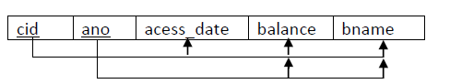
Normalization:
2NF Example:
Above relation has five attributes cid, ano, acess_date, balance, bname and two FDS
FD1 : {cid,ano} -> {acess_date,balance,bname} and
FD2 : {ano} -> {balance,bname}

Slide 93
Normalization:
2NF Example:
We have cid and ano as primary key.
As per FD2 balace and bname are only depend on ano not cid.
In above table balance and bname are partial dependent on primary key.
So above relation is not in 2NF.

Slide 94
Normalization:
2NF Example:
Problem:
For example in case of joint account multiple customers have common accounts.
If some account says ‘A02’ is jointly by two customers says ‘C02’ and ‘C04’ then data values for attributes balance and bname will be duplicated in two different tuples of customers ‘C02’ and ‘C04’.

Slide 95
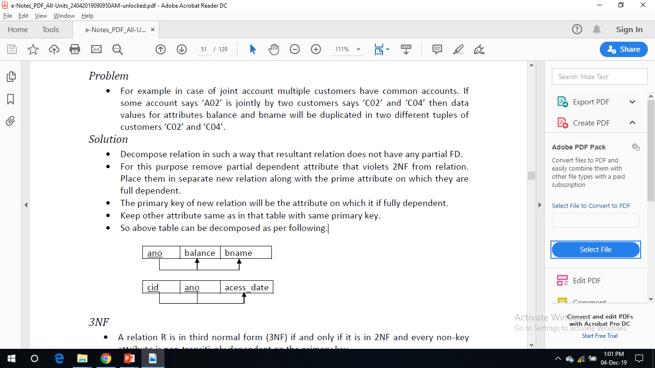
Normalization:
2NF Example:
Solution:
Decompose relation in such a way that resultant relation does not have any partial FD.
For this purpose remove partial dependent attribute that violets 2NF from relation.

Slide 96
Normalization:
2NF Example:
Solution:
Place them in separate new relation along with the prime attribute on which they are full dependent.
The primary key of new relation will be the attribute on which it if fully dependent.
Keep other attribute same as in that table with same primary key.

Slide 97
Normalization:
3NF:
A relation schema R is in third normal form (3NF) if and only if it is in 2NF and no transitive dependencies in R.

Slide 98
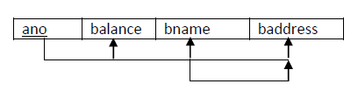
Normalization:
3NF Example:
Above relation has five attributes ano, balance, bname and baddress and two FDS
FD1 : ano -> {balance, bname, baddress} and
FD2 : bname -> baddress
Using transitivity rule, ano -> baddress

Slide 99
Normalization:
3NF Example:
So there is a non-prime attribute baddress which is transitively dependent on primary key ano.
So above relation is not in 3NF.

Slide 100
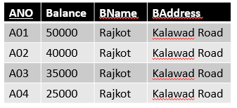
Normalization:
3NF Example:
Problem:
Transitively dependency results in data redundancy.
In this relation branch address will be stored repeatedly from each account of same branch which occupy more space.
Table 1.10 : 3NF Example

Slide 101
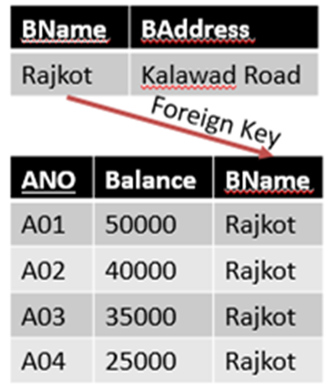
Normalization:
3NF Example:
Table 1.11 : 3NF Solution
Solution:
Decompose relation in such a way that resultant relation does not have any non-prime attribute that are transitively dependent on primary key.
For this purpose remove transitively dependent attribute that violets 3NF from relation.

Slide 102
Normalization:
3NF Example:
Table 1.11 : 3NF Solution
Solution:
Place them in separate new relation along with the non-prime attribute due to which transitive dependency occurred. primary key of new relation will be this non-prime attribute.
Keep other attributes same as in that table with same primary key.

Slide 103
Normalization:
Boyce Codd Normal Form (BCNF):
A relation R is in BCNF if and only if it is in 3NF and for every functional dependency X → Y, X should be the primary key of the table.

Slide 104
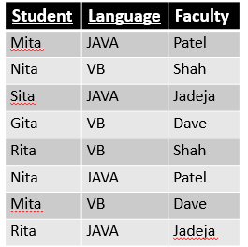
Normalization:
BCNF Example:
Let R be a relation with following three attributes: student, language, Faculty
FD1 : {student, language} → Faculty
FD2 : Faculty → language
Using transitivity rule, student → language
So above relation is not in BCNF.
Table 1.12: BCNF Example

Slide 105
Normalization:
BCNF Example:
Problem:
Transitively dependency results in data redundancy.
In this relation one student have more than one language with different faculty then records will be stored repeatedly from each student and language and faculties combination which occupies more space.
Table 1.12: BCNF Example

Slide 106
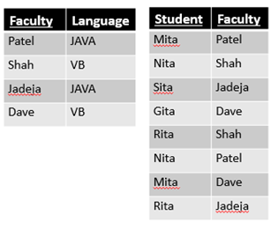
Normalization:
BCNF Example:
Solution:
Decompose relation in such a way that for X → Y, X should be the primary key of the table.
For this purpose remove prime attribute, place them in separate new relation along with the non prime attribute on which it is dependent. The primary key of new relation will be this nonprime attribute.
Table 1.13: BCNF Solution

Slide 107
Normalization:
Examples: Find out Highest NF of given Relation.
R(ABCDE), F = { ABC → D, D → A, BD → E}
Find out Candidate key: Candidate keys : { ABC, BCD}
Prime attributes: A, B, C, D. Non-Prime attributes: E
Highest NF of given Relation : 1 NF
 | BCNF | 3NF | 2NF
ABC → D | Yes | Yes | Yes
D → A | No | Yes | Yes
BD → E | No | No | No

Slide 108
Normalization:
Examples: Find out Highest NF of given Relation.
R(ABCDE), F = { A → B, B → AC, C → DE}
Find out Candidate key: Candidate keys : {A, B}
Prime attributes: A, B. Non-Prime attributes: C, D, E
Highest NF of given Relation : 2 NF
 | BCNF | 3NF | 2NF
A → B | Yes | Yes | Yes
B → AC | Yes | Yes | Yes
C → DE | No | No | Yes

Slide 109
Normalization:
Examples: Find out Highest NF of given Relation.
R(ABCDE), F = { A → BC, CD → E, B → D, E → A}
Find out Candidate key: Candidate keys : {A, E, CD, BC}
Prime attributes: A, B, C, D, E. Non-Prime attributes: none
Highest NF of given Relation : 3 NF
 | BCNF | 3NF | 2NF
A → BC | Yes | Yes | Yes
CD → E | Yes | Yes | Yes
E → A | Yes | Yes | Yes
B → D | No | Yes | Yes

Slide 110
Normalization:
Question:
A college maintains details of its lecturers' subject area skills. These details comprise: Lecturer Number, Lecturer Name, Lecturer Grade, Department Code, Department Name, Subject Code, Subject Name and Subject Level. Assume that each lecturer may teach many subjects but may not belong to more than one department. Subject Code, Subject Name and Subject Level are repeating fields. Normalize this data to Third Normal Form.

Slide 111
Normalization:
Solution:
UNF
Lecturer Number, Lecturer Name, Lecturer Grade, Department Code, Department Name, Subject Code, Subject Name, Subject Level
After removing multi valued attributes we get 1NF
Lecturer Number, Lecturer Name, Lecturer Grade, Department Code, Department Name
Lecturer Number, Subject Code, Subject Name, Subject Level (Partial Dependency)

Slide 112
Normalization:
Solution:
After removing partial dependency we get 2NF
Lecturer Number, Lecturer Name, Lecturer Grade, Department Code, Department Name (Transitive Dependency)
Lecturer Number, Subject Code
Subject Code, Subject Name, Subject Level
After removing transitive dependency we get 3NF
Lecturer Number, Lecturer Name, Lecturer Grade, Department Code
Department Code, Department Name
Lecturer Number, Subject Code
Subject Code, Subject Name, Subject Level

Slide 113
Decomposition:
Properties of Decomposition:
Dependency Preserving Decomposition / lossy
Lossless join Decomposition

Slide 114
Decomposition:
Dependency Preserving Decomposition:
Let R be the Relational schema with FD set F Decomposed into R₁, R₂, R₃…… R_{n} sub relations with FD set F₁, F₂, F₃,…….. F_{n} respectively.
R F
R₁
(F₁)
R₂
(F₂)
R₃
(F₃)

Slide 115
Decomposition:
Dependency Preserving Decomposition:
In general,
[F₁ ∪ F₂ ∪ F₃ ∪…… F_{n}] ⊆ F
If [F₁ ∪ F₂ ∪ F₃ ∪…… F_{n}] = F then it is DP Decomposition.
If [F₁ ∪ F₂ ∪ F₃ ∪…… F_{n}] ⊂ F then it is NOT DP Decomposition.

Slide 116
Decomposition:
Example 1:
R(ABCDE) is decomposed into D = { AB, BC, CD, DE }
F = { A → B, B → C, C → D, D → E, D → B }
Step 1 : Find FD’s of Sub relations:
R₁ (AB) : (F₁)
[A]⁺ = { A, B, C, D, E} [ We can derive B from A. So A → B. C,D,E are not in R₁]
[B]⁺ = { B, C, D, E} [ We cannot derive A from B.]

Slide 117
Decomposition:
Example 1:
R₂ (BC) : (F₂)
[B]⁺ = { B, C, D, E} [ We can derive C from B. So B → C. A,D,E are not in R₂]
[C]⁺ = { B, C, D, E} [ We can derive B from C. So C → B. A,D,E are not in R₂]
R₃ (CD) : (F₃)
[C]⁺ = { B, C, D, E} [ We can derive D from C. So C → D. A,B,E are not in R₂]
[D]⁺ = { B, C, D, E} [ We can derive C from D. So D → C. A,B,E are not in R₂]
R₄ (DE) : (F₄)
[D]⁺ = { B, C, D, E} [ We can derive E from D. So D → E. A,B,E are not in R₂]
[E]⁺ = {E} [ We cannot derive E from D.]

Slide 118
Decomposition:
Example 1:
{F₁ ∪ F₂ ∪ F₃ ∪ F₄ } = {A → B, B → C, C → B, C → D, D → C, D → E }
Now, F = { A → B, B → C, C → D, D → E, D → B }
We can say that If [F₁ ∪ F₂ ∪ F₃ ∪…… F_{n}] = F.
This Decomposition is Dependency Preserving Decomposition.

Slide 119
Decomposition:
Example 2:
R(ABCD) is decomposed into D = { ABC, AD, BCD }
F = { AB → CD, D → A}
Step 1 : Find FD’s of Sub relations:
R₁ (ABC) : (F₁)
[AB]⁺ = { A, B, C, D} [ We can derive C from A and B. So AB → C. D is not in R₁]

Slide 120
Decomposition:
Example 2:
R₂ (AD) : (F₂)
[A]⁺ = {A} [ We cannot derive A from D.]
[D]⁺ = { A,D} [ We can derive A from d. So D → A. A,D are not in R₂]
R₃ (BCD) : (F₃)
[B]⁺ = {B} [ We can derive D from C. So C → D. A,B,E are not in R₂]
[C]⁺ = {C} [ We can derive C from D. So D → C. A,B,E are not in R₂]
[BD]⁺ = { A, B, C, D} [ We can derive C from B and D. So BD → C. A is not in R₃]

Slide 121
Decomposition:
Example 2:
{F₁ ∪ F₂ ∪ F₃ } = {AB → C, D → A, BD → C }
Now, F = {AB → CD, D → A }
We can say that If [F₁ ∪ F₂ ∪ F₃ ∪…… F_{n}] ⊂ F.
This Decomposition is NOT Dependency Preserving Decomposition.

Slide 122
Decomposition:
Lossless join Decomposition:
Let R be the Relational schema with FD set F Decomposed into R₁, R₂, R₃…… R_{n} sub relations.
R
Before Decomposition
After Decomposition
R₁
R₂
R₃

Slide 123
Decomposition:
Lossless join Decomposition:
In general,
[R₁ ⋈ R₂ ⋈ R₃ ⋈ …… ⋈ R_{n}] ⊇ R
If [R₁ ⋈ R₂ ⋈ R₃ ⋈ …… ⋈ R_{n}] = F then it is lossless join Decomposition.
If [R₁ ⋈ R₂ ⋈ R₃ ⋈ …… ⋈ R_{n}] ⊃ F then it is lossy Decomposition.

Slide 124
Decomposition:
Lossless join Decomposition:
Consider the below Relation,
{ Sid → Sname}
Candidate key: {SidCid}
Sid | Sname | Cid
S1 | A | C1
S1 | A | C2
S2 | B | C2
S3 | B | C3

Slide 125
Decomposition:
Lossless join Decomposition:
This relation is decomposed into R₁ (SidSname) and R₂ (SidCid)
R₁ (SidSname) R₂ (SidCid) R(SidSnameCid)
R₁⋈ R₂
Sid | Sname
S1 | A
S2 | B
S3 | B
Sid | Cid
S1 | C1
S1 | C2
S2 | C2
S3 | C3
Sid | Sname | Cid
S1 | A | C1
S1 | A | C2
S2 | B | C2
S3 | B | C3
{Sid}: key
{SidCid}: key
R₁⋈ R₂ = R, so it is LOSSLESS JOIN DECOMPOSTION.

Slide 126
Decomposition:
Lossless join Decomposition:
This relation is decomposed into R₁ (SidSname) and R₂ (SnameCid)
R₁ (SidSname) R₂ (SnameCid) R(SidSnameCid)
R₁⋈ R₂
Sid | Sname
S1 | A
S2 | B
S3 | B
Sname | Cid
A | C1
A | C2
B | C2
B | C3
Sid | Sname | Cid
S1 | A | C1
S1 | A | C2
S2 | B | C2
S2 | B | C3
S3 | B | C3
S3 | B | C2
S3 | B | C3
{Sid}: key
{SidCid}: key
R₁⋈ R₂ ⊃ R, so LOSSY JOIN DECOMPOSTION.

Slide 127
Decomposition:
Lossless join Decomposition:
Common attribute should be the candidate key of one of the table.
Relational schema R with FD set F decomposed into R₁ & R₂ Decomposition is lossless if and only if,
R₁ ∩ R₂ → R₁ (R₁ ∩ R₂ ) : Candidate key for R₁ OR
R₁ ∩ R₂ → R₂ (R₁ ∩ R₂ ) : Candidate key for R₂
Union of attributes of R₁ and R₂ must be equal to the attributes of R.
Intersection of attributes in R₁ and R₂ must not be NULL.

Slide 128
Decomposition:
Example:
R(ABCDE), F = { AB → C, C → D, B → E}
Relation R is decomposed into,
D = { ABC, CD }
R₁(ABC) ∩ R₂(CD) = C
[C]⁺ = { C,D }
Here, union of attributes of R₁ and R₂ is not equal to attributes of R.
Hence, this decomposition is lossy join decomposition.

Slide 129
Decomposition:
Example:
R(ABCDE), F = { AB → C, C → D, B → E}
Relation R is decomposed into,
D = { ABC, DE }
Here, Intersection of attributes in R₁ and R₂ is NULL.
Hence, this decomposition is lossy join decomposition.

Slide 130
Decomposition:
Example:
R(ABCDE), F = { AB → C, C → D, B → E}
Relation R is decomposed into,
D = { ABC, CDE }
R₁(ABC) ∩ R₂(CDE) = C
[C]⁺ = { C,D }
CD is NOT candidate key for either of R₁ & R_{2.}
Hence, this decomposition is lossy join decomposition.

Slide 131
Decomposition:
Example:
R(ABCDE), F = { AB → C, C → D, B → E}
Relation R is decomposed into,
D = { ABCD, BE }
R₁(ABCD) ∩ R₂(BE) = B
[B]⁺ = { B,E }
CD is candidate key for R₂(BE).
Hence, this decomposition is lossless join decomposition.

Slide 132
Decomposition:
Example:
R(ABCDE), F = { AB → C, C → D, B → E}
Relation R is decomposed into,
D = { ABC, ABDE }
R₁(ABC) ∩ R₂(ABDE) = AB
[AB]⁺ = { A,B,C,D,E }
AB is candidate key for both tables R₁ (ABC) and R₂(ABDE).
Hence, this decomposition is lossless join decomposition.

Slide 133
Decomposition:
Example:
R(ABCDE), F = { AB → C, C → D, B → E}
Relation R is decomposed into,
D = { ABC, CD, BE }
R₁(ABC) ∩ R₂(CD) = C
[C]⁺ = { C,D }
CD is candidate key for either of R₂(CD).
R₁⋈ R₂ (ABCD) ∩ R₃(BE) = B, [B]⁺ = { B,E }
B is candidate key for R₃(BE).
Hence, this decomposition is lossless join decomposition.

Slide 134
Decomposition:
Example:
R(ABCDE), F = { AB → C, C → D, B → E}
Relation R is decomposed into,
D = { ABC, CD, DE }
R₁(ABC) ∩ R₂(CD) = C
[C]⁺ = { C,D }
CD is candidate key for either of R₂(CD).
R₁⋈ R₂ (ABCD) ∩ R₃(DE) = D, [D]⁺ = { D }
D is NOT candidate key for any table.
Hence, this decomposition is lossy join decomposition.

Slide 135
Section - 3
Query Processing and Optimization

Slide 136
Topics
Query processing
Steps in query processing
Measures of query cost
Selection operation
Evaluation of expressions
Query optimization
Transformation of relational expressions
Sorting and join

Slide 137
Query Processing
Query Processing is process to convert high level queries to low level so machine can understand and perform the action that are requested by the user.
It is used to extract data from database and to fetch data it takes three steps:
Parsing and Translation
Optimization
Evaluation

Slide 138


Steps in Query Processing
Parser checks the syntax of query and verifies attribute name and relation name
Translator translates the query into its internal form (relational algebra)
Parser and translator
SQL Query
Relational algebra
expression
Choose best execution plan
Optimizer
Execute the query-evaluation plan and returns output
Evaluation
engine
Query Result
Execution plan
Data
Data
Data
Database Catalog Statistics about Data

Slide 139
Step in Query Processing
Parsing and Translation:
SQL is suitable for humans.
Relational Algebra is suitable for system.
First step in query processing is to convert SQL to Relational Algebra Expression.
Parsing(Parser):
Check Syntax
Check Schema Elements
Translation(Translator)
Parse Tree Relational Algebra

Slide 140
Step in Query Processing
Optimization(Optimizer):
Selects the best Query Evaluation Plan to evaluate the query.
Generate Query Evaluation Plan for all possible option
Query Evaluation plan = Query Tree + Algorithms

Slide 141
Step in Query Processing
Evaluation Engine:
Evaluates the Query Plan (selected by Optimizer) and fetches the data from database.

Slide 142
Measures of Query cost
Total time taken by statement/query to execute and to fetch data from database is Query Cost.
Some factors are:
Communication cost:
Applicable to distributed/parallel system.
CPU Cycles:
Difficult to calculate
CPU speed improves at much faster rate as compared to Disk speed

Slide 143
Measures of Query cost
Disk Access:
Dominates the total time to execute a query
Disk Access Cost:
No. of seeks
No. of blocks Read
No. of Blocks Write
Note: Generally cost of writing is greater than cost of reading.

Slide 144
Selection operation
File Scan: Search algorithm that used to locate and retrieve data that satisfy a selection condition in a file.
Symbol for Selection operator: σ (Sigma)
Syntax: σ _{condition} (Relation)
Searching algorithm for Selection Operation:
Linear Search(A1)
Binary Search(A2)

Slide 145
Selection operation
Linear Search(A1):
This algorithm will search and scan all blocks available and tests all records/data to determine whether or not they satisfy the selection condition.
Cost(A1) = B_{R} (worst case)
where B_{R} denotes number of blocks
If the condition is on a Key(primary) attribute, then system can stop searching if desired record found.
Cost(A1) = B_{R}/2 (best case)
If the condition is on non (primary) key attribute, then multiple blocks may contain desired records, then the price of scanning such blocks have to be added to the estimate value.
This is slower than Binary Search.

Slide 146
Selection operation
Binary Search(A2):
File (relation) ordered based on attribute A (primary index).
Cost(A2) = log₂(B_{R})
This is faster than Linear Search.

Slide 147
Evaluation of expressions
Query(Expression) may contain multiple operations and due to that solving query (Expression) will be difficult.
To evaluate such type of Query we have to solve one by one in proper order.
There are two methods to evaluate multiple operations expression:
Materialization
Pipelining
Π_{Name}
Execution
Bottom to top
σ_{Balance<25000}
(Customer)
(Account)

Slide 148
Materialization
Materialization starts the bottom of the expression and performs a single operation at a time.
Materialized(store in temporary relation) each intermediate result of all operations performed and use this result as input to evaluate next-level operations.
The cost of materialization can be quite high as overall cost can be compute as:
Overall Cost = Sum of Costs of individual operations + Cost of writing intermediate results to the disk
Disadvantages of Materializations are:
Due to intermediate results, it creates lots of temporary relations.
It performs many Input/Output operations.

Slide 149
Pipelining
In Pipelining, the output of one operation is passed as input to another operation. i.e. it forms a queue.
As the output of one operation is passed to the next operation in the Pipelines, the number of intermediate temporary relations will be reduced.
Performing operations in Pipeline eliminates the cost of writing and reading temporary relations.
It can be executed in two ways:
Demand Driven(Lazy Evaluation)
Producer Driven(Eager Pipelining)

Slide 150
Pipelining(Cont..)
Demand Driven(Lazy Evaluation):
System repeatedly requests for tuples from operation at the top of pipeline.
Producer Driven(Eager Pipelining):
Operations do not wait for request to produce tuples, but generate the tuples eagerly.

Slide 151
Query Optimization
Query optimization is the process of choosing the best evaluation plan having lowest cost from the available multiple plans.
For Example,
Customer
CID | ANO | Name
CSE1 | A1 | Jay
CSE2 | A2 | Abhi
CSE3 | A3 | Parth
CSE4 | A4 | Pratik
Π_{Name} ( σ_{Balance<25000} (Account) (Customer))
Efficient plan
2 records
4 records
Account
ANO | Balance
A1 | 30000
A2 | 10000
A3 | 20000
A4 | 40000
Π_{Name} ( σ_{Balance<25000} (Account Customer) )
4 records
4 records

Slide 152
Query Optimization Approaches
Cost Based Optimization (Exhaustive Search Optimization):
In this, it initially generates all possible plans and then select the best plan from it.
Its provides the best solution.
Heuristic Based Optimization:
These technique is less expensive.
To decide optimized query execution plan there are some heuristic rules:
To reduce the number of tuples, Perform selection as early as possible.
To reduce the number of attributes, Perform projection as early as possible.
Perform most restrictive selection and join operations (i.e. with smallest result size) before other similar operations.

Slide 153
Transformation of relational expressions
Two relational algebra expressions are said to be equivalent if the two expressions generate the same set of tuples on every legal database instance.
An equivalence rule says that expressions of two forms are equivalent.
Can replace expression of first by second, or vice versa.

Slide 154
Transformation of relational expressions(Conti..)
For Example,
Customer
Account
CID | ANO | Name
CSE1 | A1 | Jay
CSE2 | A2 | Abhi
CSE3 | A3 | Parth
CSE4 | A4 | Pratik
ANO | Balance
A1 | 30000
A2 | 10000
A3 | 20000
A4 | 40000
Π_{Name} ( σ_{Balance<25000} (Account) (Customer) )
Π_{Name} ( σ_{Balance<25000} (Account Customer) )
Customer
Name
Meet
Jay

Slide 155
Equivalence Rules
Conjunctive(Combined) selection operations can be deconstructed into sequence of individual selections. This is known as Cascade of σ.
Customer
CID | ANO | Name | Balance
CS1 | 1 | Jay | 30000
CS2 | 2 | Abhi | 10000
CS3 | 3 | Parth | 20000
CS4 | 4 | Pratik | 40000
σ_{ANO<3 Λ Balance<20000} (Customer)
Output
OUTPUT
CID | ANO | Name | Balance
CSE2 | 2 | Abhi | 10000
σ_{ANO<3} (σ_{Balance<20000} (Customer))
σ_{θ1Λθ2} (E) = σ_{θ1} (σ_{θ2} (E))

Slide 156
Equivalence Rules
Selection operations are commutative
If many projection used in expression then only the last in a sequence of projection operations is required. So Omit all other projection operation.
Selection operation can be combined with Cartesian products and theta joins.
σ_{θ1} (σ_{θ2} (E)) = σ_{θ2} (σ_{θ1} (E))
Π_{L1} (Π_{L2} (…(Π _{Ln} (E))…)) = Π_{L1} (E)
σ_{θ} (E1 E2)) = E1 _{θ}E2
σ_{θ1} (E1 _{θ2} E2)) = E1 _{θ1Λ θ2} E2

Slide 157
Equivalence Rules
Theta-join operations (and natural joins) are commutative.
Natural join operations are associative
E1 σ_{θ} E2 = E2 σ_{θ} E1
(E1 E2) E3 = E1 (E2 E3)

Slide 158
Equivalence Rules
The selection operation distributes over the theta join operation under the following two conditions:
(a) When all the attributes in θ₀ involve only the attributes of one of the expressions (E₁) being joined. σ_{θ0}(E₁ _{θ} E₂) = (σ_{θ0}(E₁)) _{θ} E₂
(b) When θ₁ involves only the attributes of E₁ and θ₂ involves only the attributes of E₂.
σ_{θ1}∧_{θ2} (E₁ _{θ} E₂) = (σ_{θ1}(E₁)) _{θ} (σ_{θ2} (E₂))

Slide 159
Equivalence Rules
The projection operation distributes over the theta join operation as follows:
(a) if θ involves only attributes from L₁ ∪ L₂:
(b) Consider a join E_{1 θ} E₂.
Let L₁ and L₂ be sets of attributes from E₁ and E₂, respectively.
Let L₃ be attributes of E₁ that are involved in join condition θ, but are not in L₁ ∪ L₂, and
Let L₄ be attributes of E₂ that are involved in join condition θ, but are not in L₁ ∪ L₂.
∏
(
E
E
)
=
(
∏
(
E
))
(
∏
(
E
))
L
∪
L
1
θ
2
L
1
θ
L
2
1
2
1
2
∏
(
E
E
)
=
∏
((
∏
(
E
))
(
∏
(
E
)))
L
1
∪
L
2
1
θ
2
L
1
∪
L
2
L
1
∪
L
3
1
θ
L
2
∪
L
4
2

Slide 160
Equivalence Rules
The set operations union and intersection are commutative
E₁ ∪ E₂ = E₂ ∪ E₁ E₁ ∩ E₂ = E₂ ∩ E₁
Note: set difference is not commutative
Set union and intersection are associative.
(E₁ ∪ E₂) ∪ E₃ = E₁ ∪ (E₂ ∪ E₃)
(E₁ ∩ E₂) ∩ E₃ = E₁ ∩ (E₂ ∩ E₃)

Slide 161
Equivalence Rules
The selection operation distributes over ∪, ∩ and –.
σ_{θ} (E₁ – E₂) = σ_{θ} (E₁) – σ_{θ}(E₂) and similarly for ∪ and ∩ in place of –
Also: σ_{θ} (E₁ – E₂) = σ_{θ}(E₁) – E₂ and similarly for ∩ in place of –, but not for ∪
The projection operation distributes over union
Π_{L}(E₁ ∪ E₂) = (Π_{L}(E₁)) ∪ (Π_{L}(E₂))

Slide 162
Sorting
We can build an index on the relation, so use the index to read the relation in sorted order. May cause one disk block access for every tuple.
For relations that slot(fit) in memory, techniques like quicksort may be used. For relations that don’t slot in memory, external sort-merge is used.

Slide 163
External Sort-Merge
Let M denote memory size (in pages).
Create sorted runs as follows. Let i be 0 initially. Repeatedly do the following till the end of the relation:
(a) Read M blocks of relation into memory
(b) Sort the in-memory blocks
(c) Write sorted data to run Ri; increment i.
Merge the runs; suppose for now that i < M. In a single merge step, use i blocks of memory to buffer input runs, and 1 block to buffer output. Repeatedly do the following until all input buffer pages are empty:
(a) Select the first record in sort order from each of the buffers
(b) Write the record to the output
(c) Delete the record from the buffer page; if the buffer page is empty, read the next block (if any) of the run into the buffer.

Slide 164
Example - External Sorting using Sort-Merge
24
19
31
33
14
16
16
21
3
2
7
14
24
19
31
19
24
31
14
16
19
24
31
33
2
3
7
14
14
16
16
19
21
24
31
33
Blocks = 3
33
14
16
14
16
33
3
16
21
2
3
7
14
16
21
16
21
3
2
7
14
create
runs
2
7
14
merge
pass-1
merge
pass-2
initial relation
runs
runs
sorted output

Slide 165
External Sort-Merge(Conti..)
If i ≥ M, several merge passes are required.
In each pass, contiguous groups of M − 1 runs are merged.
A pass reduces the number of runs by a factor of M − 1, and creates runs longer by the same factor.
Repeated passes are performed till all runs have been merged into one.
Cost analysis:
Disk accesses for initial run creation as well as in each pass is 2b_{r} (except for final pass, which doesn’t write out results)
Total number of merge passes required: [log_{M−1}(b_{r}/M)].
Thus total number of disk accesses for external sorting:
b_{r}(2[log_{M−1}(b_{r}/M)] + 1)

Slide 166
Join Strategies
Several different algorithms to implement joins
Nested-loop join
Block nested-loop join
Indexed nested-loop join
Merge-join
Hash-join

Slide 167
Nested-Loop join
To compute the join r _{θ}s
for each tuple t_{r} in r do begin
for each tuple t_{s} in s do begin
test pair (t_{r}, t_{s}) to see if they satisfy the join condition θ
if they do, add t_{r} • t_{s} to the result.
end
end
r is called the outer relation and s the inner relation of the join
Requires no indices and can be used with any kind of join condition
Expensive since it examines every pair of tuples in the two relations

Slide 168
Nested-Loop join (conti..)
Assuming worst case memory availability and the following given statistics for the relations customer and depositor
Number of records of customer: 10,000 (n_{customer})
Number of records of depositor: 5,000 (n_{depositor})
Number of blocks of customer: 400 (b_{customer})
Number of blocks of depositor: 100 (b_{depositor})
Estimate the cost
with depositor as outer relation
with customer as outer relation

Slide 169
Nested-Loop join (conti..)
Assuming worst case memory availability and the following given statistics for the relations customer and depositor
Number of records of customer: 10,000 (n_{customer})
Number of records of depositor: 5,000 (n_{depositor})
Number of blocks of customer: 400 (b_{customer})
Number of blocks of depositor: 100 (b_{depositor})
Estimate the cost
with depositor as outer relation
No. of blocks access = n_{depositor} * b_{customer} + b_{depositor}
= 5000 * 400 + 100
= 2000100

Slide 170
Nested-Loop join (conti..)
Assuming worst case memory availability and the following given statistics for the relations customer and depositor
Number of records of customer: 10,000 (n_{customer})
Number of records of depositor: 5,000 (n_{depositor})
Number of blocks of customer: 400 (b_{customer})
Number of blocks of depositor: 100 (b_{depositor})
Estimate the cost
with customer as outer relation
No. of blocks access = n_{customer} * b_{depositor} + b_{customer}
= 10000 * 100 + 400
= 1000400

Slide 171
Nested-Loop join (conti..)
Assuming best case memory availability and the following given statistics for the relations customer and depositor
Number of records of customer: 10,000 (n_{customer})
Number of records of depositor: 5,000 (n_{depositor})
Number of blocks of customer: 400 (b_{customer})
Number of blocks of depositor: 100 (b_{depositor})
Estimate the cost
with customer as outer relation
No. of blocks access = b_{depositor} + b_{customer}
= 100 + 400
= 500

Slide 172
Cost of computing for all joins
P is the outer relation and Q is the inner relation of the join.
Number of records of P: (N_{P})
Number of records of Q: (N_{Q})
Number of blocks of P: (B_{P})
Number of blocks of Q: (B_{Q})
c is the cost of a single selection on Q using the join condition.
Join | Worst Case | Best Case
Nested-Loop Join | B_{P} + N_{P} ∗ B_{Q} | B_{P} + B_{Q}
Block Nested-Loop Join | B_{P} + B_{P} ∗ B_{Q} | B_{P} + B_{Q}
Index Nested-Loop Join | B_{P} + N_{P} ∗ c
Merge Join | B_{P} + B_{Q}
Hash-Join | 3 ∗ (B_{P} + B_{Q})

Slide 173
References
[1] Abraham Silberschatz, Henry F. Korth and S. Sudarshan, Database System Concepts, McGraw-Hill Education (Asia), Seventh Edition, 2019.
[2] C. J. Date, A. Kannan and S. Swamynathan, An Introduction to Database Systems, Pearson Education, Eighth Edition, 2009.
[3] Database Management Systems, CSE, DIET, https://www.darshan.ac.in/DIET/CE/GTU-Computer-Engineering-Study-Material
[4] Database management systems by Raghu Ramakrishnan and Johannes Gehrke http://pages.cs.wisc.edu/~dbbook/openAccess/thirdEdition/slides/slides3ed.html
[5] Database management system tutorial, https://www.tutorialspoint.com/dbms/index.htm
[6] Vishal Hatmode, Sonali Rangdale, 2014, Query Optimization Based on Heuristic Rules, INTERNATIONAL JOURNAL OF ENGINEERING RESEARCH & TECHNOLOGY (IJERT) Volume 03, Issue 07 (July 2014).

Slide 174


www.paruluniversity.ac.in

